Slide 1
Дистрибутивная семантика. Векторные модели
Презентация: Дарья Попова, Дарья Рыжова
Анна Полянская, 202

Slide 2
Основные предположения
Ludwig Wittgenstein:
Die Bedeutung eines Wortes liegt in seinem Gebrauch.
Firth (1935:37) on context dependence (cited by Stubbs):
the complete meaning of a word is always contextual, and no study of meaning apart from context can be taken seriously.
Firth (1957:11):
You shall know a word by the company it keeps . . .
Harris (1954:34):
All elements in a language can be grouped into classes whose relative occurrence can be stated exactly. However, for the occurrence of a particular member of one class relative to a particular member of another class, it would be necessary to speak in terms of probability, based on the frequency of that occurrence in a sample.

Slide 3
Основные предположения
Harris (1954:34):
[I]t is possible to state the occurrence of any element relative to any other element, to the degree of exactness indicated above, so that distributional statements can cover all of the material of a language without requiring support from other types of information.
Harris (1954:34) (anticipating deep learning?):
[T]he restrictions on relative occurrence of each element are described most simply by a network of interrelated statements, certain of them being put in terms of the results of certain others, rather than by a simple measure of the total restriction on each element separately.

Slide 4
Основные предположения
Harris (1954:36) on levels of analysis:
Some question has been raised as to the reality of this structure. Does it really exist, or is it just a mathematical creation of the investigator’s? Skirting the philosophical difficulties of this problem, we should, in any case, realize that there are two quite different questions here.
One: Does the structure really exist in language? The answer is yes, as much as any scientific structure really obtains in the data which it describes — the scientific structure states a network of relations, and these relations really hold in the data investigated.
Two: Does the structure really exist in speakers? Here we are faced with a question of fact which is not directly or fully investigated in the process of determining the distributional structure. Clearly, certain behaviors of the speakers indicate perception along the lines of the distributional structure, for example, the fact that while people imitate nonlinguistic or foreign-language sounds, they repeat utterances of their own language.

Slide 5
Основные предположения
Harris (1954:39) on meaning and context-dependence:
All this is not to say that there is not a great interconnection between language and meaning, in whatever sense it may be possible to use this work. But it is not a one-to-one relation between morphological structure and anything else. There is not even a one-to-one relation between vocabulary and any independent classification of meaning; we cannot say that each morpheme or word has a single central meaning or even that it has a continuous or coherent range of meanings.[. . . ] The correlation between language and meaning is much greater when we consider connected discourse.

Slide 6
Основные предположения
Harris (1954:43):
The fact that, for example, not every adjective occurs with every noun can be used as a measure of meaning difference. For it is not merely that different members of the one class have different selections of members of the other class with which they are actually found. More than that: if we consider words or morphemes A and B to be more different than A and C, then we will often find that the distributions of A and B are more different than the distributions of A and C. In other words, difference in meaning correlates with difference in distribution.

Slide 7
Основные предположения
Turney & Pantel (2010:153):
Statistical semantics hypothesis: Statistical patterns of human word usage can be used to figure out what people mean (Weaver, 1955; Furnas et al., 1983). – If units of text have similar vectors in a text frequency matrix, then they tend to have similar meanings. (We take this to be a general hypothesis that subsumes the four more specific hypotheses that follow.)
Bag of words hypothesis: The frequencies of words in a document tend to indicate the relevance of the document to a query (Salton et al., 1975). – If documents and pseudo-documents (queries) have similar column vectors in a term–document matrix, then they tend to have similar meanings.
Distributional hypothesis: Words that occur in similar contexts tend to have similar meanings (Harris, 1954; Firth, 1957; Deerwester et al., 1990). – If words have similar row vectors in a word–context matrix, then they tend to have similar meanings.
Extended distributional hypothesis: Patterns that co-occur with similar pairs tend to have similar meanings (Lin & Pantel, 2001). – If patterns have similar column vectors in a pair–pattern matrix, then they tend to express similar semantic relations.
Latent relation hypothesis: Pairs of words that co-occur in similar patterns tend to have similar semantic relations (Turney et al., 2003). – If word pairs have similar row vectors in a pair–pattern matrix, then they tend to have similar semantic relations.

Slide 8
Какое значение у слова «bardiwac»?
Примеры из BNC:
He handed her her glass of bardiwac.
Beef dishes are made to complement the bardiwacs.
Nigel staggered to his feet, face flushed from too much bardiwac.
Malbec, one of the lesser-known bardiwac grapes, responds well to Australia’s sunshine.
I dined off bread and cheese and this excellent bardiwac.
The drinks were delicious: blood-red bardiwac as well as light, sweet Rhenish.
Stefan Evert

Slide 9
Какое значение у слова «bardiwac»?
bardiwac is a heavy red alcoholic beverage made from grapes

Slide 10
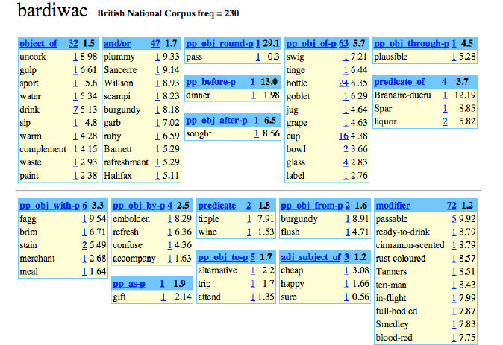
Какое значение у слова «bardiwac»?

Slide 11
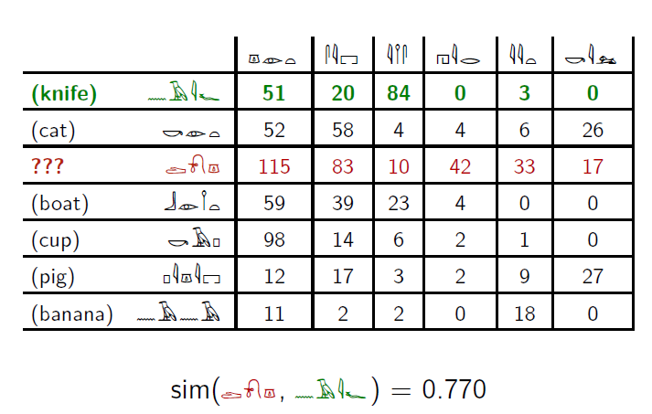
Ментальный эксперимент: дешифровываем иероглифы
Stefan Evert

Slide 12
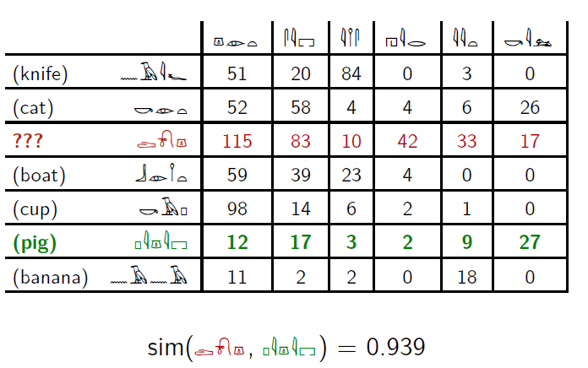
Ментальный эксперимент: дешифровываем иероглифы
Stefan Evert

Slide 13
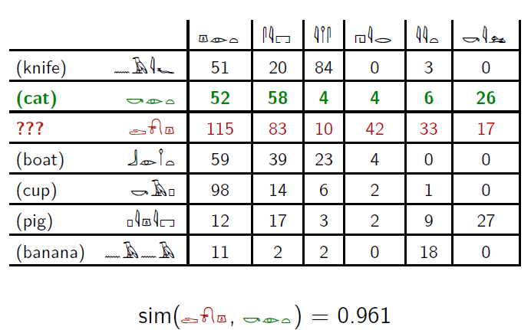
Ментальный эксперимент: дешифровываем иероглифы
Stefan Evert

Slide 14
Что это за слово?
Notes:
Ответ: собака

Slide 15
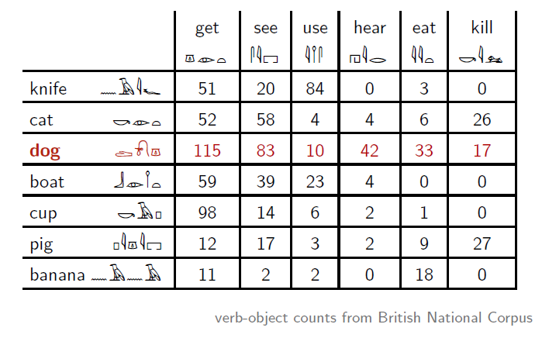
Как компьютер видит английский…
Stefan Evert

Slide 16
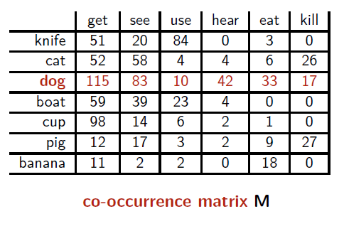
Геометрическая интерпретация
вектор xdog описывает использование слова dog в корпусе
значения вектора могут рассматриваться как координаты слова в n-мерном пространстве
Stefan Evert

Slide 17
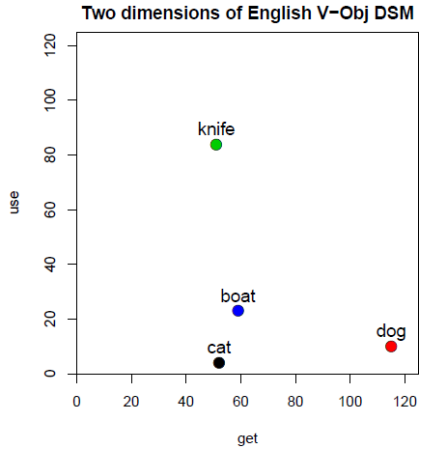
Геометрическая интерпретация
вектор xdog описывает использование слова dog в корпусе
значения вектора могут рассматриваться как координаты слова в n-мерном пространстве
Проиллюстрировано двумя измерениями: get и use
xdog = (115,10)
Stefan Evert

Slide 18
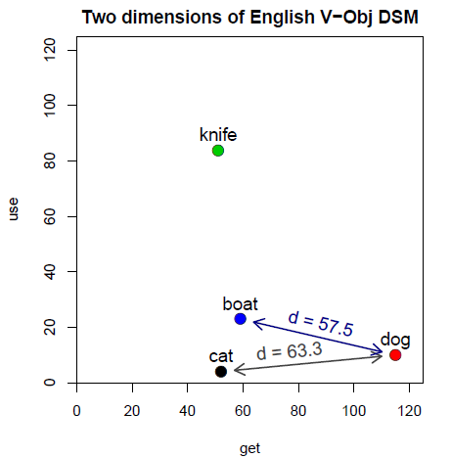
Геометрическая интерпретация
схожесть (similarity) = близость в пространстве
расположение зависит от частотности
fdog ≈ 2.7 * fcat
Stefan Evert

Slide 19
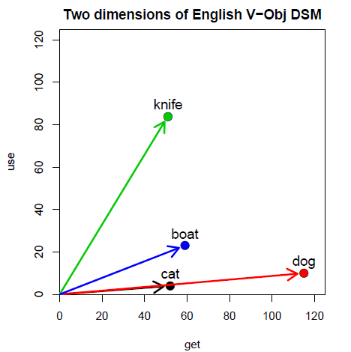
Геометрическая интерпретация
схожесть (similarity) = близость в пространстве
расположение зависит от частотности
fdog ≈ 2.7 * fcat
направление более важно, чем расположение
Stefan Evert

Slide 20
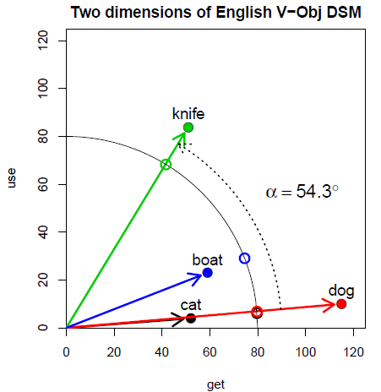
Геометрическая интерпретация
схожесть (similarity) = близость в пространстве
расположение зависит от частотности
fdog ≈ 2.7 * fcat
направление более важно, чем расположение
угол α можно использовать для измерения расстояния
Stefan Evert

Slide 21
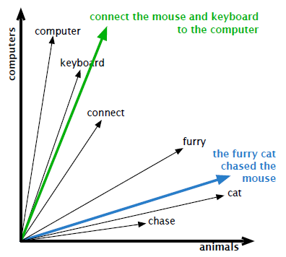
дистрибутивная репрезентация на уровне типов
Stefan Evert

Slide 22
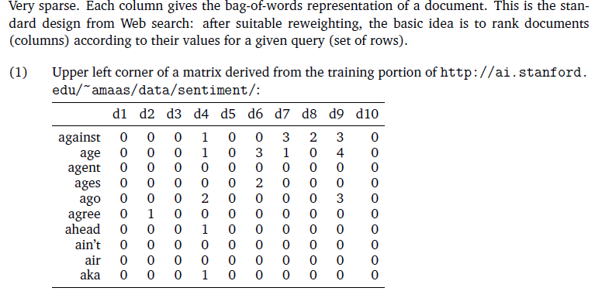
Параметры дизайна: матрица: слово x документ

Slide 23
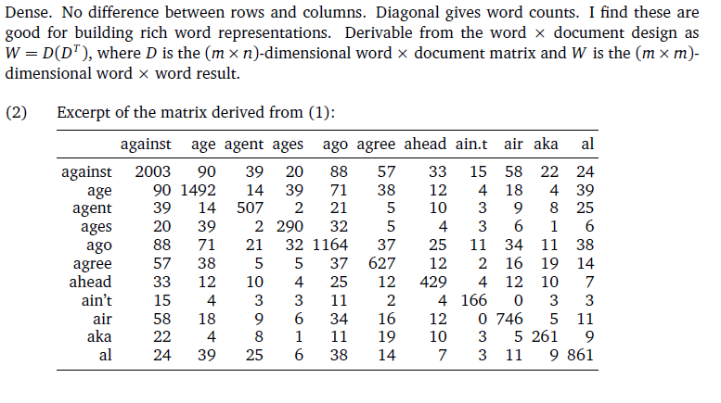
Параметры дизайна: матрица: слово x слово

Slide 24
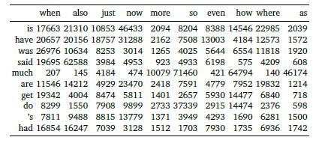
Параметры дизайна: матрица: модифицируемое x адверб

Slide 25
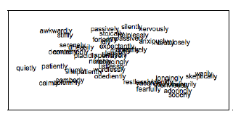
Параметры дизайна: матрица: модифицируемое x адверб

Slide 26
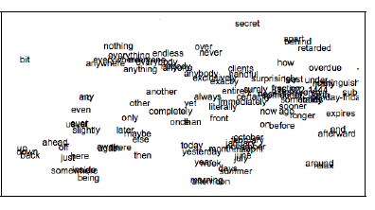
Параметры дизайна: матрица: модифицируемое x адверб

Slide 27
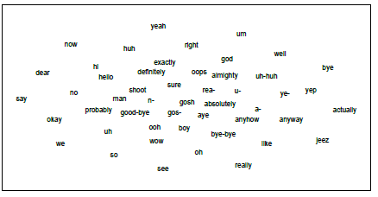
Параметры дизайна: матрица: восклицание x речевой акт (Switchboard dialog act)

Slide 28
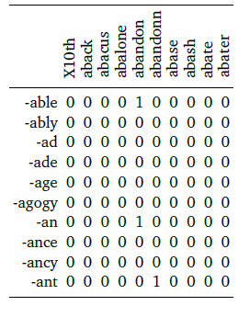
Параметры дизайна: матрица: аффикс x основа (google N-grams)

Slide 29

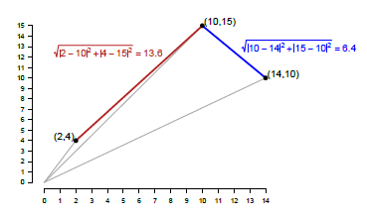
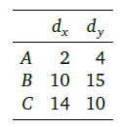
Параметры дизайна: расстояние: Эвклидово расстояние (Euclidian distance)

Slide 30

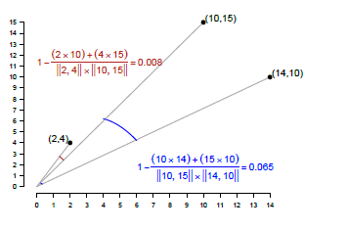
Параметры дизайна: расстояние: косинусное расстояние (cosine distance)

Slide 31
Параметры дизайна: уменьшение размерности
PCA = Principal Component Analysis (метод главных компонент)
SVD = Single Value Decomposition (видео1, видео2) -> LSA = Latent Semantic Analysis

Slide 32
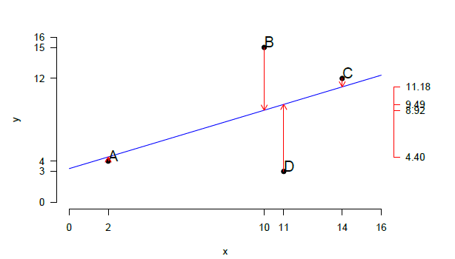
Параметры дизайна: уменьшение размерности

Slide 33
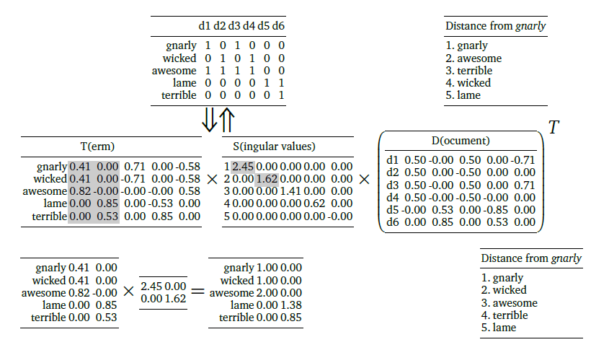

Параметры дизайна: уменьшение размерности: LSA

Slide 34
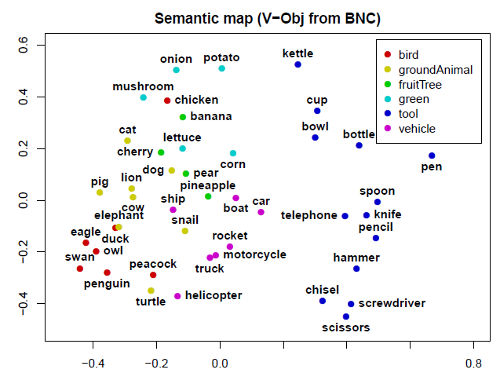
Параметры дизайна: кластеризация: семантические карты
Stefan Evert

Slide 35
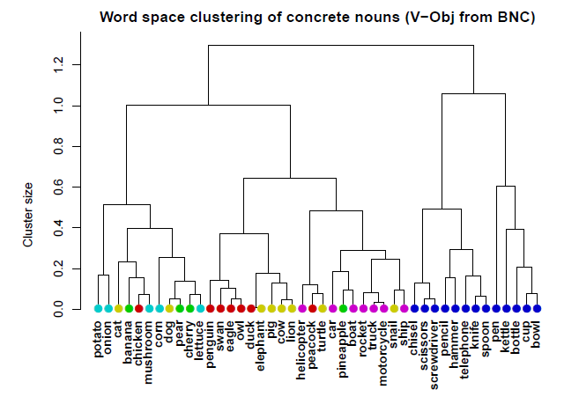
Параметры дизайна: кластеризация:
Stefan Evert

Slide 36
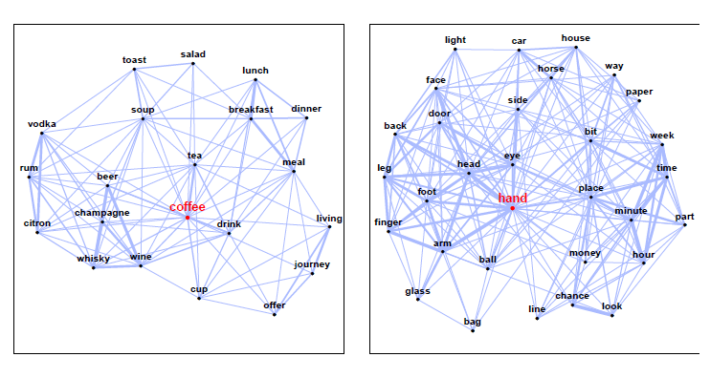
Параметры дизайна: кластеризация: графы
Stefan Evert

Slide 37
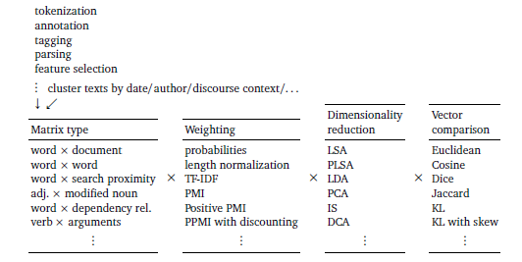
Еще немнго о дизайне

Slide 38
Математика: частые термины
TF-IDF – Term Frequency – Inverse Document Frequency
PMI – Pointwise Mutual Information
LSA – Latent Semantic Analysis
PLSA – Probabilistic Latent Semantic Analysis
PCA – Principal Component Analysis
LDA -- Latent Dirichlet Allocation
DCA – Decline Curve Analysis
KL – Kullback-Leibler Divergence

